Slide 1
Caption Generator
Guide Name: Dr. S Thenmozhi Vijaykumar R Pai
Associate Professor, Dept. of CA PES1201702013
PES University

Slide 2
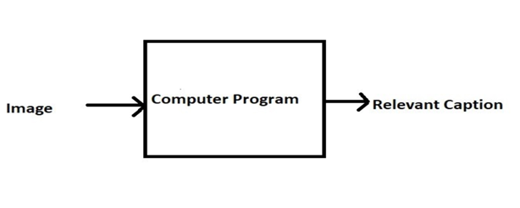

ABSTRACT
Caption Generator is a Machine Learning application which identifies the action portrayed in the given image.
The generated caption will describe about the image which will say what kind of actions is taking place in it.

Slide 3
INTRODUCTION
This project involves Computer Vision and Natural Language Processing concepts to recognize the context of an image and describe them in a natural language like English.
The objective of the project is to build a working model of Caption Generator by implementing CNN with LSTM.
The basic working of the application is that the features are extracted from the images using pre-trained VGG16 model and then fed to the LSTM model along with the captions to train.
The trained model is then capable of generating captions for any images that are fed to it.

Slide 4
LITERATURE SURVEY
You saw an image and your brain can easily tell what the image is about, but can a computer tell what the image is representing?
With the advancement in Deep learning techniques and availability of huge datasets and computer power, it is possible to build models that can generate captions for an image.
Therefore, with this application it is possible to generate captions for any images once they are uploaded. Later on, if the text-to-speech feature is enabled on the devices, it will help in converting the generated captions into speech which will be helpful for the visually impaired person in knowing the actions taking in the images.

Slide 5
TOOLS AND TECHNOLOGIES
Frontend: HTML, CSS, Bootstrap
Backend: Flask 1.x
Language: Python 3.7
Storage (Dataset): AWS S3 Bucket
IDE: Jupyter Notebook

Slide 6
FUNCTIONAL REQUIREMENTS
User launches the application.
User uploads the images for which the captions are to be generated.
User clicks on the submit button.
Within a matter of seconds, the CNN and LSTM algorithms recognizes and process the context of an image.
The page is redirected and the caption is generated for the respective image.

Slide 7
NON – FUNCTIONAL REQUIREMENTS
Availability
Maintainability
Performance
Supportability

Slide 8
MODULES
Data Gathering
Images for training the model
Corpus for Image captions
Object identification
Feature extraction from images
Model Generation using CNN
Building LSTM (Long Short Term Memory) model.
Validating the Model
Development of web application.
Deploy the ML model in the web application

Slide 9
APPLICATION IN THE REAL WORLD
If the caption is converted to speech it will be helpful for the visually impaired person
Auto subtitling

Slide 10
THANK YOU

